Slide 1
Identifying Twitter Troll Accounts in Mueller Investigation
Team Popeye
Piyusha Sane
Manisha Chaurasia
Rishabh Kumar
Aman Wagadre
Tushar Rathi

Slide 2
Background and Problem
2016 US Presidential Election
Russian government interference
Twitter troll accounts increase political instability
Identify troll accounts on Twitter whose goal is to
Spread
“discord, mistrust, and fear”

Slide 3
Train and Test Data for Supervised Learning
2,425,909 tweets between March 28 and April 5
Train Data
Verified and Non-verified Accounts
Verified Accounts
NBC-identified Troll Accounts
Real
Troll
Test Data

Slide 4




Characteristic Features of Bots / Trolls
Stolen profile pics
Retweet from catalyst accounts
Reply predefined content
#WonHackAuton
#AI
#Sleepy
#Tired
Loser !
Loser !
Loser !
Loser !

Slide 5
Detailed Feature Analysis
Semantic similarity
Only news headlines without links
Retweet rate high during apex of event
Replace original link in the retweet
Coordination amongst several other troll accounts
Similar account creation date for multiple accounts
Activity Gaps
Recent accounts
Telltale account names
Tweeting in intervals
Geo location
Retweet rate is high

Slide 6
Data to Preliminary Features
Users
User id
User location
User Name
Followers Count
Statuses Count
Time Zone
Verification
Language
Screenname
Favorites Count
Listed Count
Friends Count
Preliminary Features
Followers count
Status count
Time zone
Verified account
Language
Favorites count
Listed count
Number of tweets
Active days
Average tags (Penn Treebank)
Sentiment value
Tweets
User id
Screenname
Tweet created date
Tweet text
Tweet id
Mentions

Slide 7
Our Proposed Model
Semantic
features
Multi-Layer Perceptron
Supervised learning technique
Non-linear activation function
Model hyper-parameters yet to be finalized
Profile
Features

Slide 8
Timeline
Prediction of Troll Accounts
Problem Identification
Data
Pre-processing
Feature Engineering
Train Model
Data Analysis
Feature Identification
Model Generation
Profile Image as Features

Slide 9

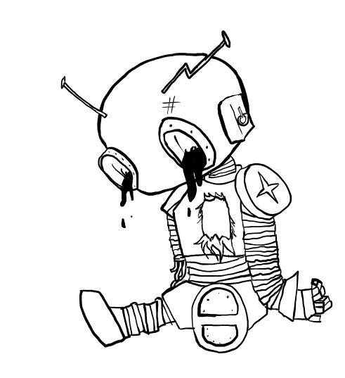
Thank You

